Slide 1

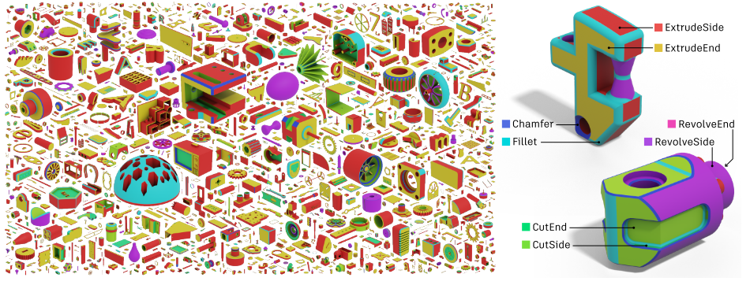
AI-supported Automated Feature Recognition
Task
Automated feature recognition is the first and the most important step in the process of translation of CAD information into some instructions appropriate for intelligent manufacturing.
Your task is to develop and compare 3D feature extraction and surface segmentation algorithms for CAD models and 3D meshes
Project Characteristics
Modeling:
Mathematics:
Programming:
Science:
General Instructions:
Introduction to geometric deep learning and 3D feature extraction
Preprocessing of data input for feature recognition CAD models, 3D Meshes
Implementing of relevant data-driven algorithms for 3D geometry segmentation and feature extraction
Comparing results from different AI and data-driven approaches
Close collaboration will take place with TEBIS, a specialist in Computer-Aided Design/Manufacturing (CAD/CAM) providing consulting and training data for the developed algorithms.
Figure : BrepNet [1] segmentation outcomes
[1] J. G. Lambourne, K. D. D. Willis, P. K. Jayaraman, A. Sanghi, P. Meltzer, and H. Shayani, “BrepNet: A topological message passing system for solid models,” Proc. IEEE Comput. Soc. Conf. Comput. Vis. Pattern Recognit., pp. 12768–12777, 2021, doi: 10.1109/CVPR46437.2021.01258.

