Slide 1
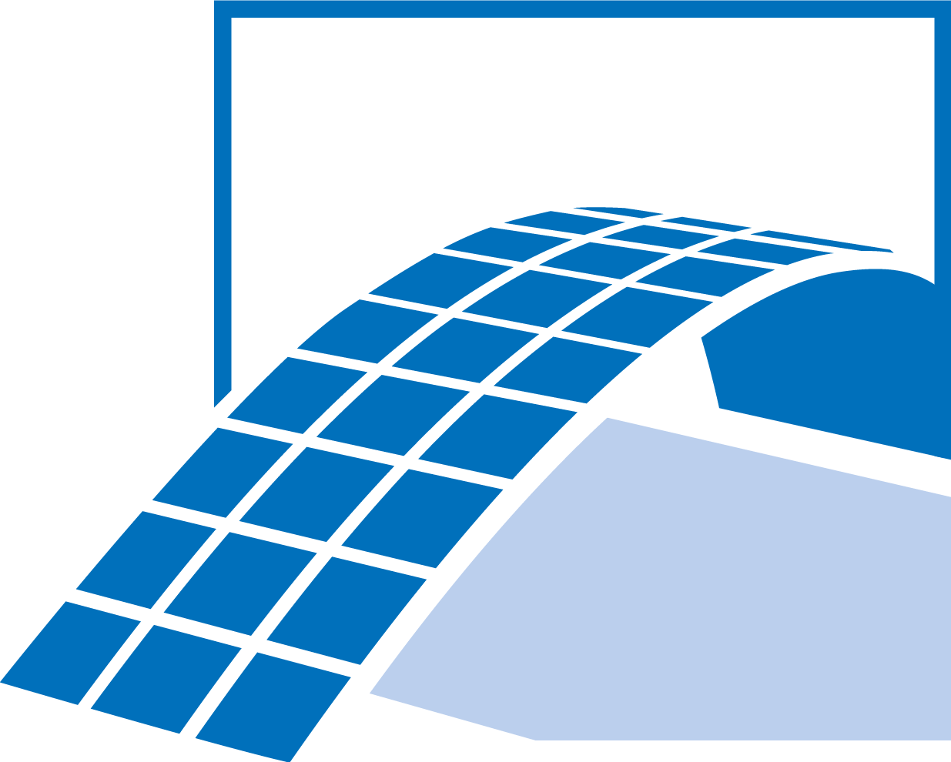
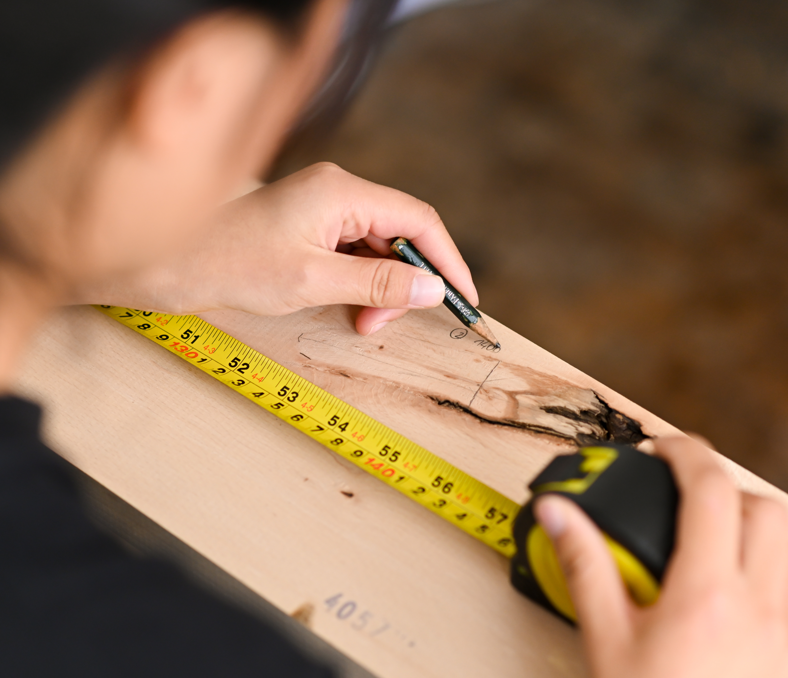
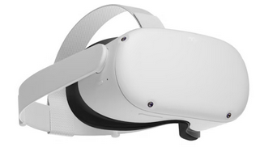
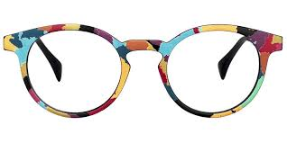
Augmented reality for quality assessment of timber boards
Project Characteristics
Modeling:
Mathematics:
Programming:
Science:
Evaluating mechanical properties of timber boards is an important task for the growing usage of this material in engineering application. Due to the high natural scatter of this material as well as its high amount of anisotropy and heterogeneity, different technologies should be used for evaluation of this material. Up to now this process is done manually, by measuring the coordinates of each imperfection at the lab. One possible way for reconstruction of timber boards is the usage of glasses.
Your tasks in this project would be:
Evaluation of the images/videos from the glasses
Registration of the imperfections
3D-Reconstruction of the boards with imperfections

