Slide 1
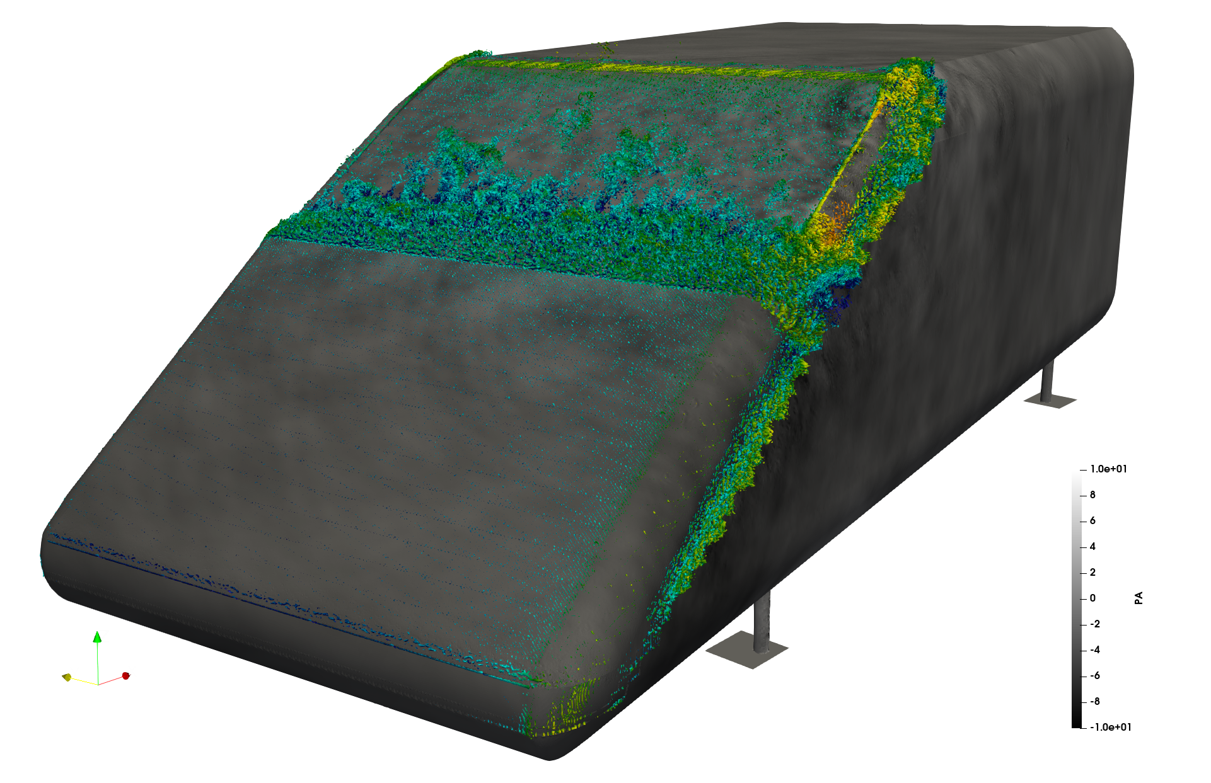
Project Characteristics
Implementation of offloading the scalar transport for GPU computing in the MGLET framework
Modeling:
Mathematics:
Programming:
Science:
Task
Analyse and benchmark different implementation strategies
Identify possible bottlenecks
Implement GPU acceleration for scalar transport in MGLET base¹
Successfully run a benchmark test case
[1] https://github.com/kmturbulenz/mglet-base
[2] SAE-Body at 38.89m/s; acoustic pressure on surface, isosurface of Q-criterium coloured with velocity
F. Schwertfirm/KM-Turbulenz/f.schwertfirm@km-turbulenz.de - S. Wenczowski/Hydromechanics/simon.wenczowski@tum.de
<Foliennummer>

