Slide 1
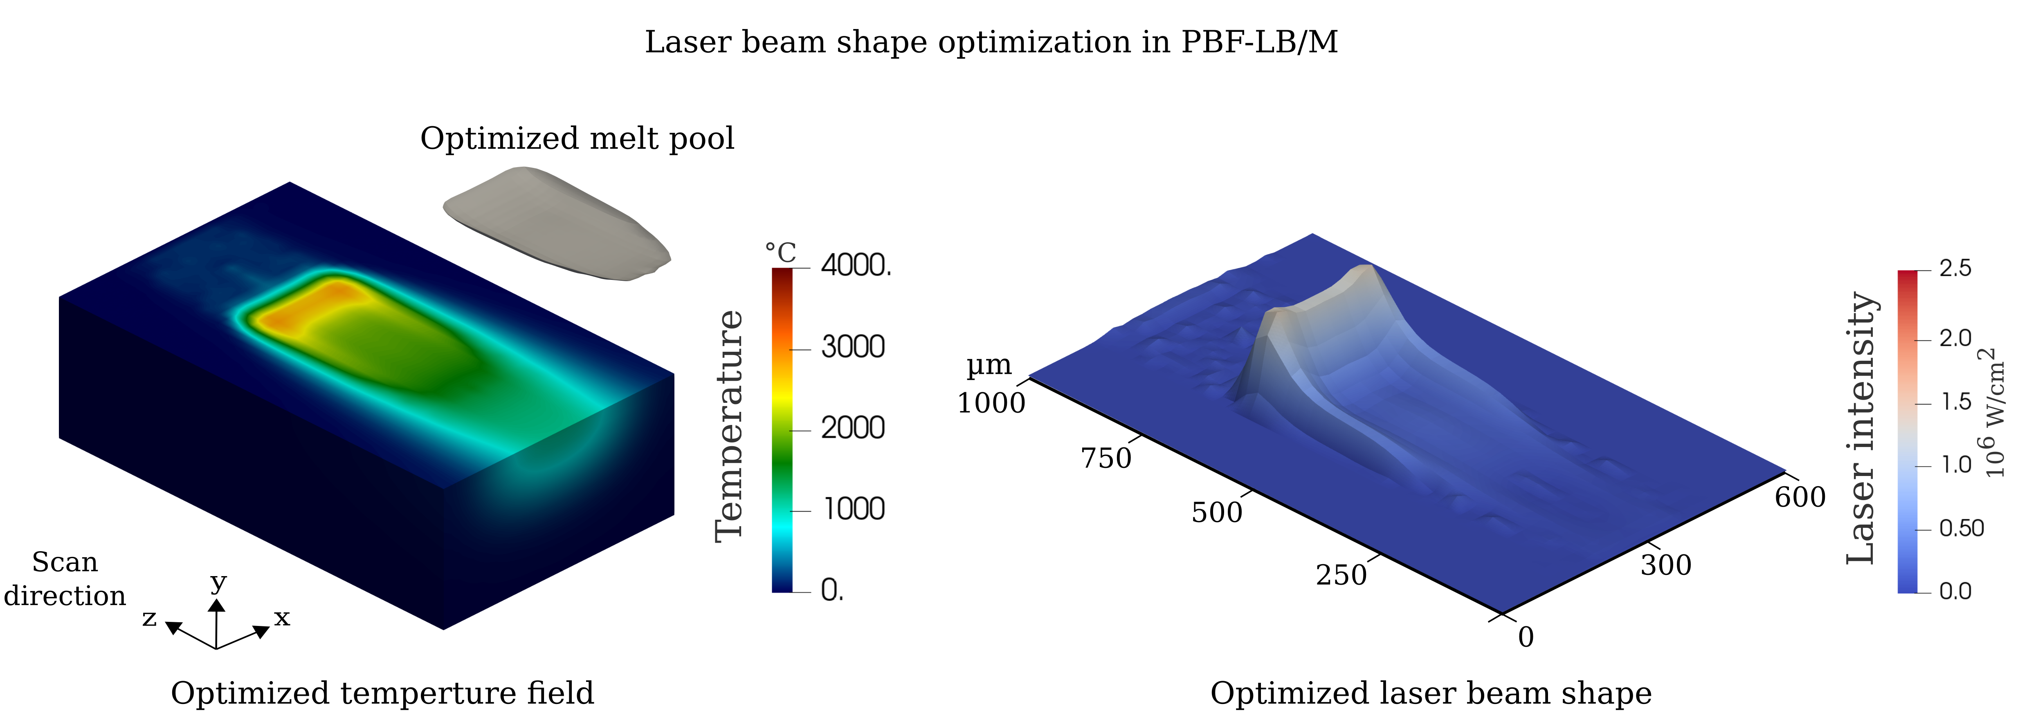
Optimal Control of Thermal Gradients in Laser-Based Additive Manufacturing Processes
Project Characteristics
Task
To develop an adjoint-based optimization method for a non-linear heat quation for applications in laser-based additive manufacturing processes (python)
Develop a finite element method to solve non-linear heat equation to compute heat evolution and cooling rate from a given laser intensity distribution
Derive the corresponding adjoint-state equation
Set-up the inverse/adjoint solver
Optimize the laser intensity distribution for different thermal gradients
Modeling:
Mathematics:
Programming:
Science:
Optimal control of temperature distribution/melt pool in PBF-LB/M[1]
[1] Holla, Vijaya, Philipp Kopp, Jonas Grünewald, Katrin Wudy, and Stefan Kollmannsberger. "Laser Beam Shape Optimization in Powder Bed Fusion of Metals." Available at SSRN 4265496 (2022).

