Slide 1
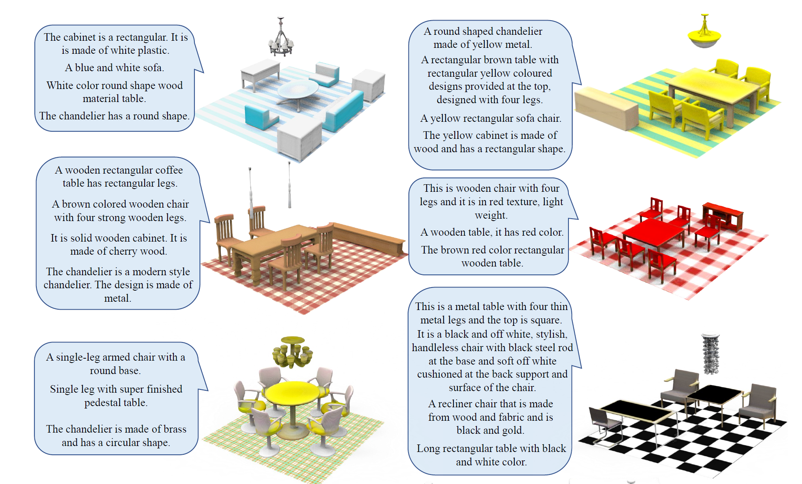
Towards language driven 3D content generation in building environments
Project Characteristics
Modeling:
Mathematics:
Programming:
Science:
Task
The task of text-to-3D focuses on automatically generating corresponding 3D assets based on text descriptions. The project aim to develop a framework that generates 3D design from text description:
Perform literature review to identify state-of-the-arts methods that address similar research challenge.
Constructing datasets suitable for text-to-3d tasks in building domain (e.g., using parametric modeling tools)
Implement algorithms that performs the task.
[1] Z. Liu, J. Hu, K. H. Hui, X. Qi, D. Cohen-Or und C. W. Fu, „EXIM: A Hybrid Explicit-Implicit Representation for Text-Guided 3D Shape Generation,“ in ACM Transactions on Graphics, 2023.
From text to 3D [1]

