Slide 1

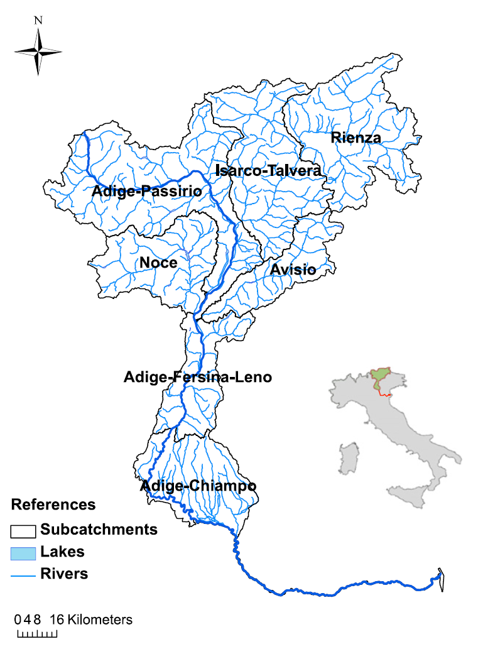
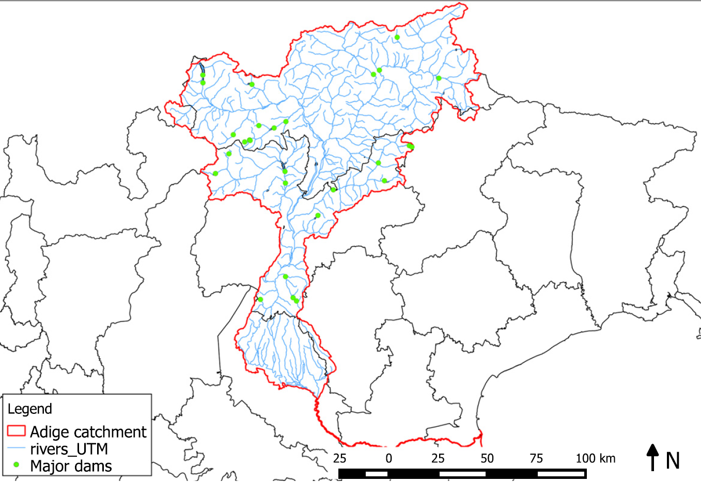
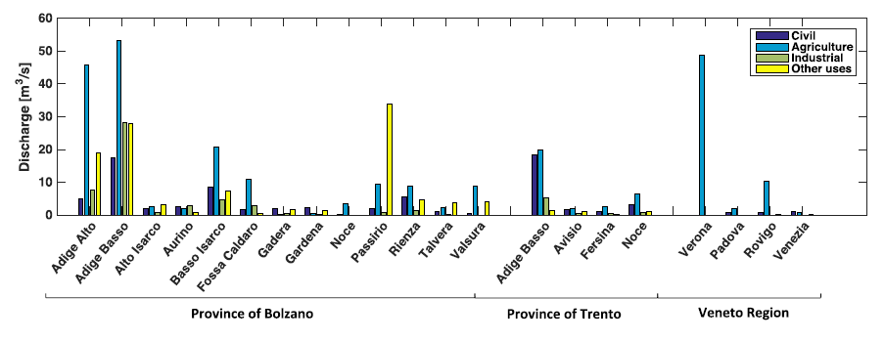
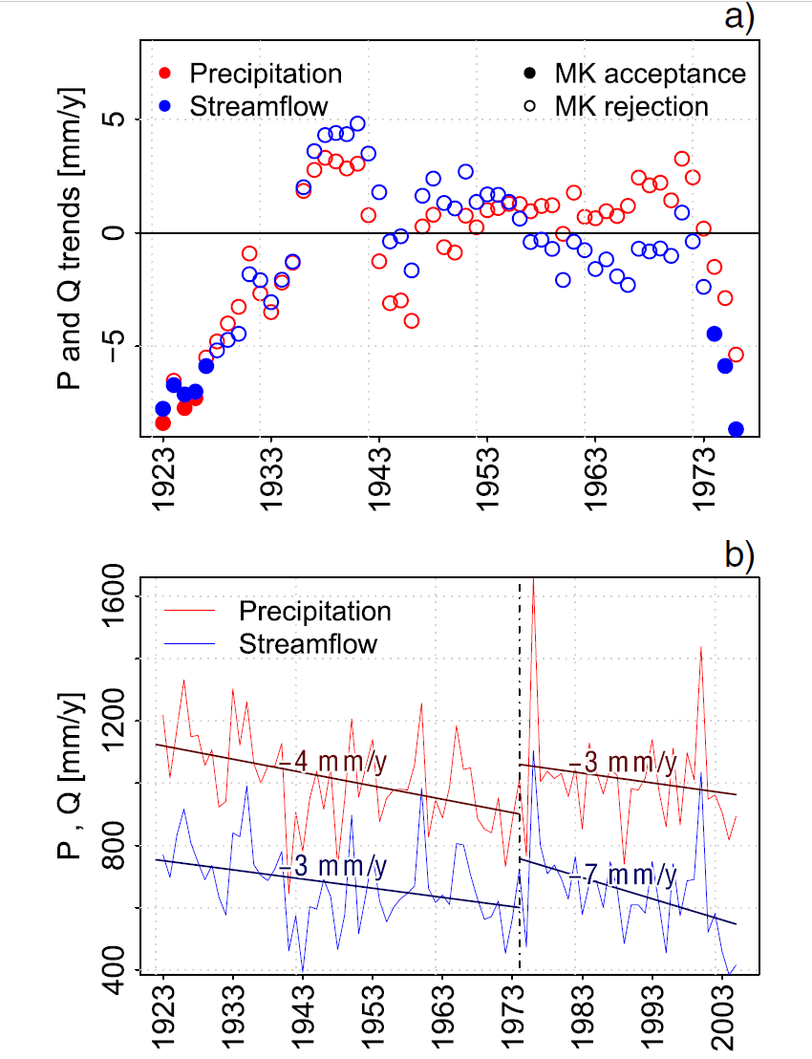
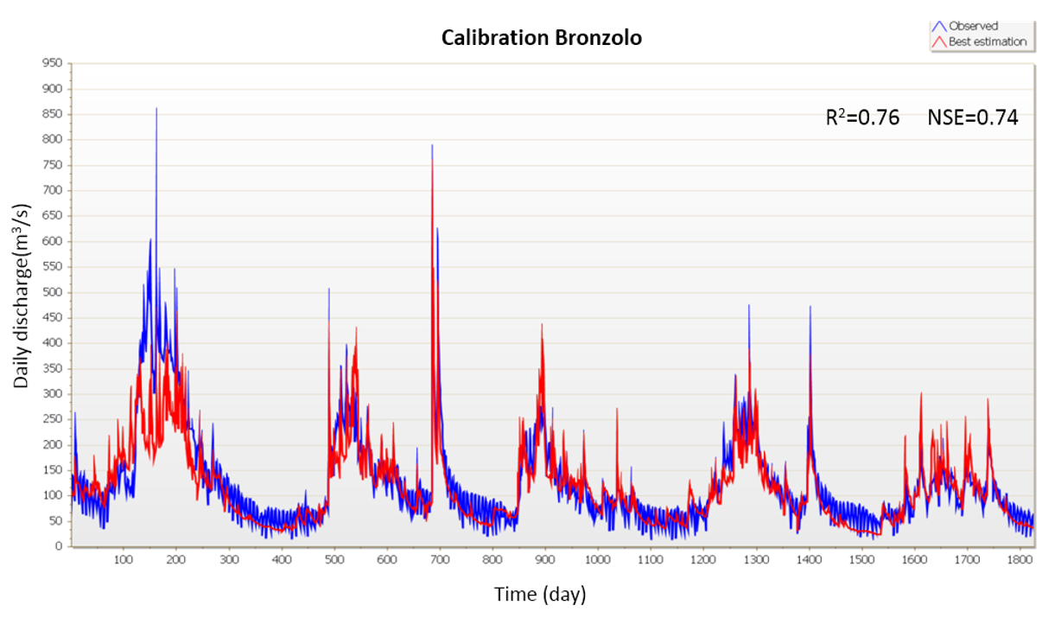
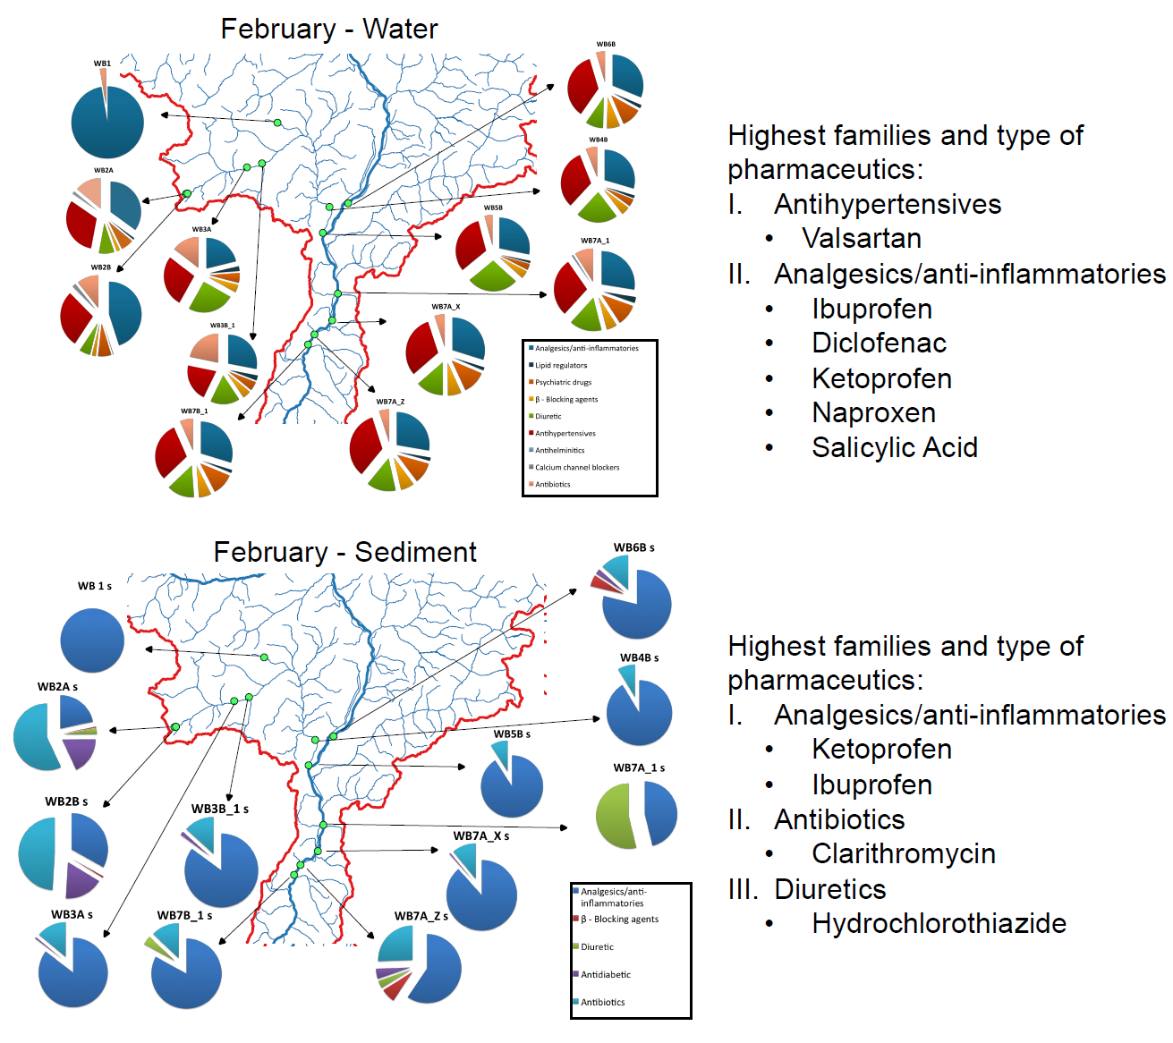
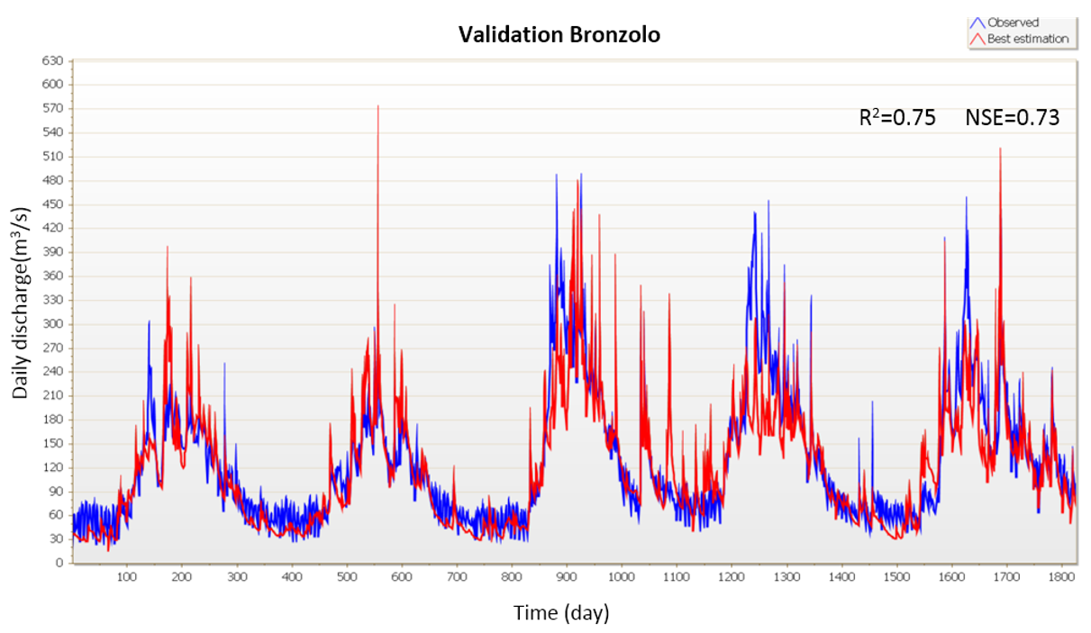
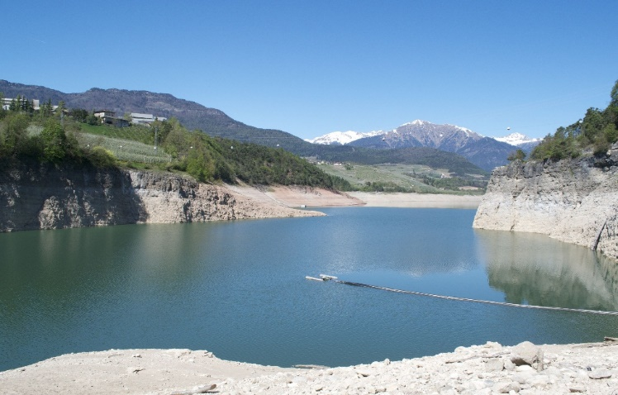

Chair of Hydrology and River Basin Management
Faculty of Civil, Geo and Environmental Engineering
Prof. Dr.-Ing Markus Disse
Hydrological stressors within the Adige catchment (North-East Italy)
Gabriele Chiogna¹, Alberto Bellin², Bruno Majone², Karina Cano Paoli², Elena Diamantini², Elisa Stella², Stefano Mallucci², Ye Tuo¹, Markus Disse¹
¹ Technical University of Munich, Faculty of Civil, Geo and Environmental Engineering, Arcistrasse 21, 80333 Munich, Germany
² Università degli Studi di Trento, Dipartimento di Ingegneria Civile Ambientale e Meccanica, via Mesiano 77, 38123, Trento, Italy
Abstract
The GLOBAQUA project has been funded by the European commission in the 7th framework Programme, in order to improve management of the effects of multiple stressors on aquatic ecosystems under water scarcity. Six case studies, representative of different climatic conditions, have been selected to address this issue. The Adige catchment has been chosen to represent the Alpine region. The Adige is the second longest river in Italy, with a length of 410 km and a drainage area of 12000 km². In this catchment, the main stressor for the aquatic ecosystem derives form hydrological alterations. Indeed, because of its morphology and humid climate, the river basin is well suited for hydroelectric production, and to date 30 major reservoirs exist in the catchment, for a total storage capacity equal to 8.5% of the long-term mean annual runoff. Natural streamflow is significantly affected by hydropower production, particularly at intermediate and low flow regimes. Furthermore, earlier snow melting is already affecting the Adige river basin reducing water resources availability during the irrigation period (roughly June-August). Indeed, higher temperatures recorded in the summer months may cause an increase of water demand for irrigation and for energy production used for cooling. This is expected to increase the deficit of water resources in summer, when agricultural and recreational uses reach the highest water demand. As a consequence, an exacerbation in the conflicts between different users of water resources can be expected. Furthermore, induced hydropeaking effects can also have severe consequences on contaminant loads transported in the stream. Another important stressor of the aquatic ecosystem relevant for the upper part of basin, may be the release of pollutants (e.g., POPs & DDT) accumulated in the glaciers and the release of emerging pollutants (e.g., drugs, pharmaceuticals and personal care products, in particular UV filters) from the WWTPs serving the ski resorts. In this context, hydrological modeling will contribute: i) to monitor the impact of the main stressors on the basin; ii) to develop a sediment and pollutant transport model and the interactions between surface water, groundwater and the hyporheic zone; iii) to develop policies for sustainable hydropower tourism and agriculture activities; iv) to provide policies for adaptation considering water management under climate change conditions.
Hydrology and water uses in the Adige catchment
Catchment Description
Water uses
The Adige river rises from a spring in proximity of the Resia lake at the elevation of 1586 m a.s.l. and after 409 km it ends in the Adriatic sea. The mean water discharge registered at Boara Pisani gauging station is about 202 m3/s, with peaks usually registered in the period from June to September, showing the typical behavior of Alpine catchments. According to the last report from the basin authority glaciers cover an area of 212 km2, corresponding to 1.9% of the catchment's area at Verona. Glaciers strongly influence the annual flow regime of the Adige river. Hence, they are carefully monitored due to the increasing concern related to the observed acceleration in melting caused by rising air temperatures. Analysis of land cover changes as retrieved by CORINE (www.eea.europa.eu/publications/COR0-landcover) products in 1990 and 2006 showed that glaciers have reduced their surface extent with a negative trend of about 2.3 km2/year. Climate in the Adige river basin is characterized by dry winters, snow and glacier-melt in spring, whereas it is humid during summer and autumn. Annual average precipitation values range between 500 mm in Val Venosta and 1600mm in the southern part of the basin. The Adige river provides water to 34 large hydropower plants (average nominal capacity larger than 3 MW) with a total effective power of 650 MW.
The Adige River Basin
CLIMATE CHANGE + HYDROPEAKING + EMERGING POLLUTANTS
a) Trends and Mann-Kendall significance test b) time series of average annual Q registered in Trentino and catchment-avereaged P.
Natural streamflow (red line) vs altered streamflow (blue line) for the gauging station of Bronzolo computed for the period 2001 -2010
Preliminary results of the first global sampling campaign performed within the Globaqua project. The occurence of emerging pollutants in the catchment can be correlated with touristic acivities.
References
Chiogna G., Majone B., Cano Paoli K., Diamantini E., Stella E., Mallucci S., Lencioni V., Zandonai F., Bellin A., 2016, Science of the Total Environment, 540,429-443
This research was partially supported by the European Communities 7th Framework Programme under Grant Agreement No. 603629-ENV-2013-6.2.1-Globaqua
Technische Universität München
Chair of Hydrology and River Basin Management
Head of Chair: Prof. Dr.-Ing. Markus Disse
www.hydrologie.bgu.tum.de
 +49 89 289 23225
 gabriele.chiogna@tum.de

